Slide 1
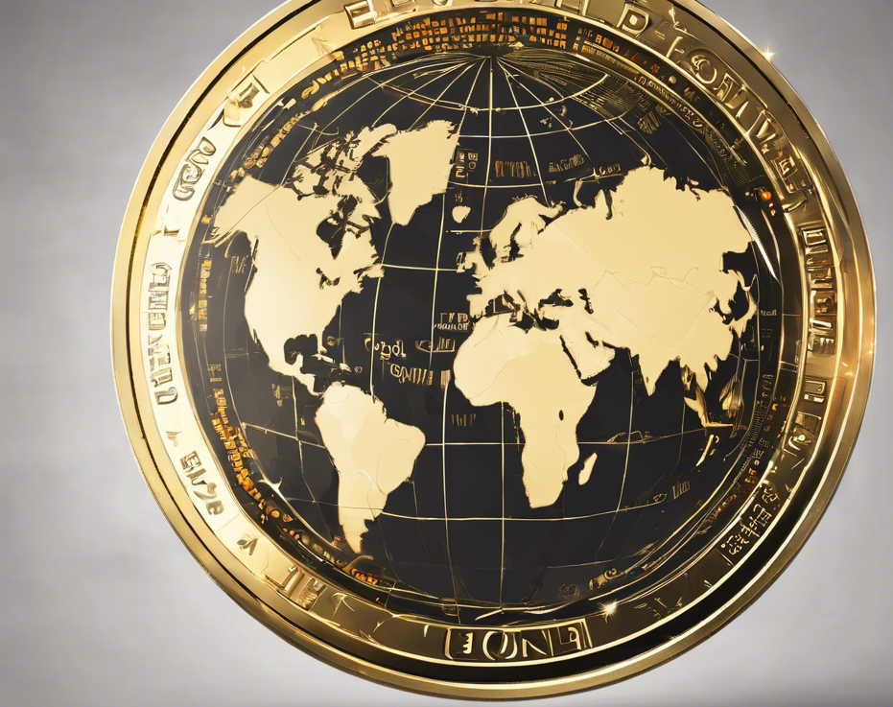
Introducing Global Coin 12 March 2024
Harith Alshuwaykh
Sam Muslin
Montgomery Gash
Erin O’Leary
https://www.youtube.com/watch?v=u66eOJSJTfs

Slide 2

Agenda
Briefer: Erin O’Leary
Executive Summary
Process: Remix/Solidity
Process: Streamlit
Flow Chart
Future Improvements
Q & A

Slide 3
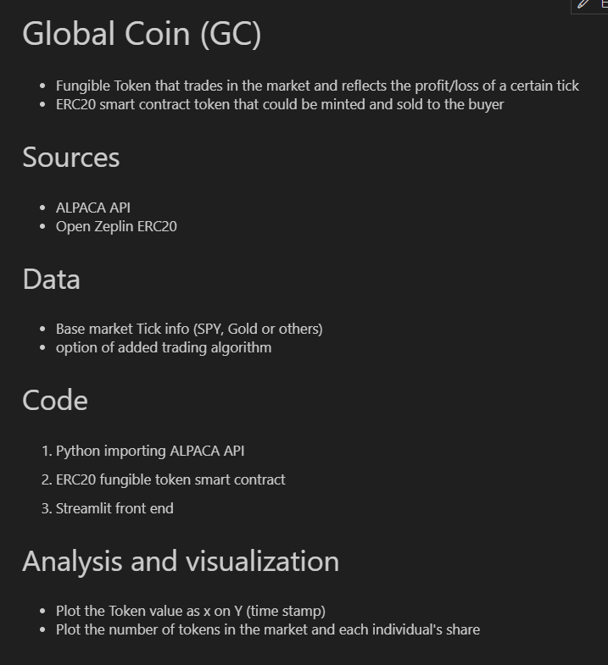
Briefer: Erin O’Leary
So What?

Slide 4
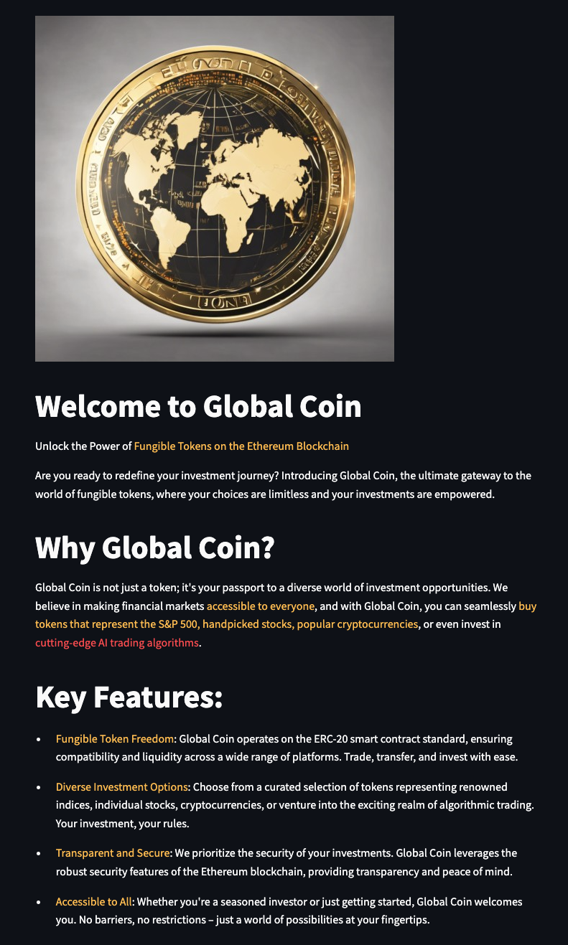
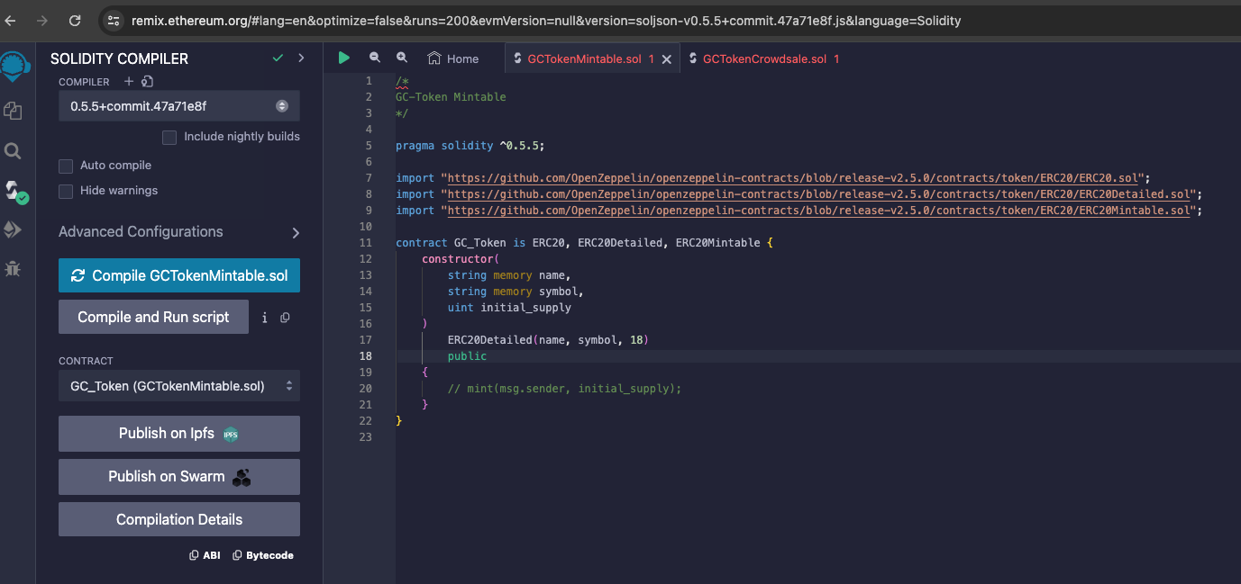
Briefer: Harith Alshuwaykh
Global Coin
Notes:
Used MACD, verified by ADX, for buy and sell signal generation.

Slide 5

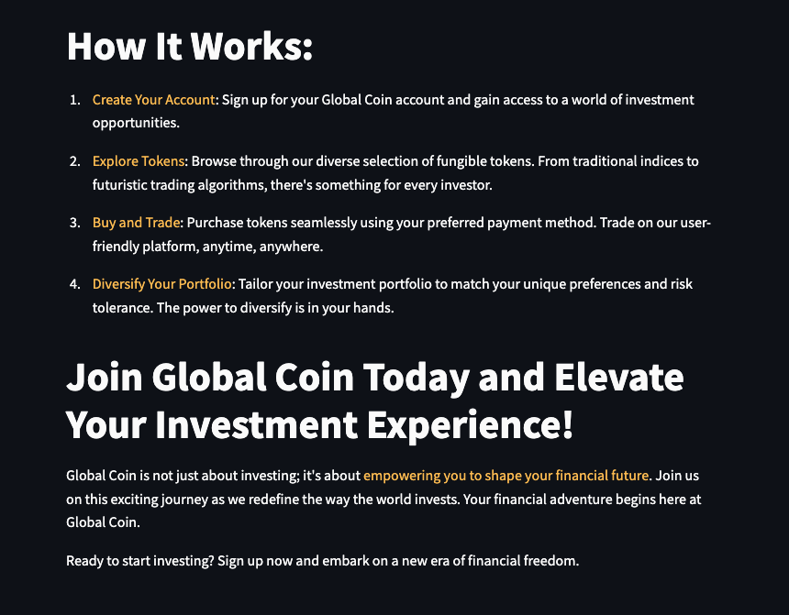
Briefer: Harith Alshuwaykh
Features
Notes:
Used MACD, verified by ADX, for buy and sell signal generation.

Slide 6
Compile Solidity Apps for Token
Briefer: Sam Muslin
Notes:
Used MACD, verified by ADX, for buy and sell signal generation.

Slide 7
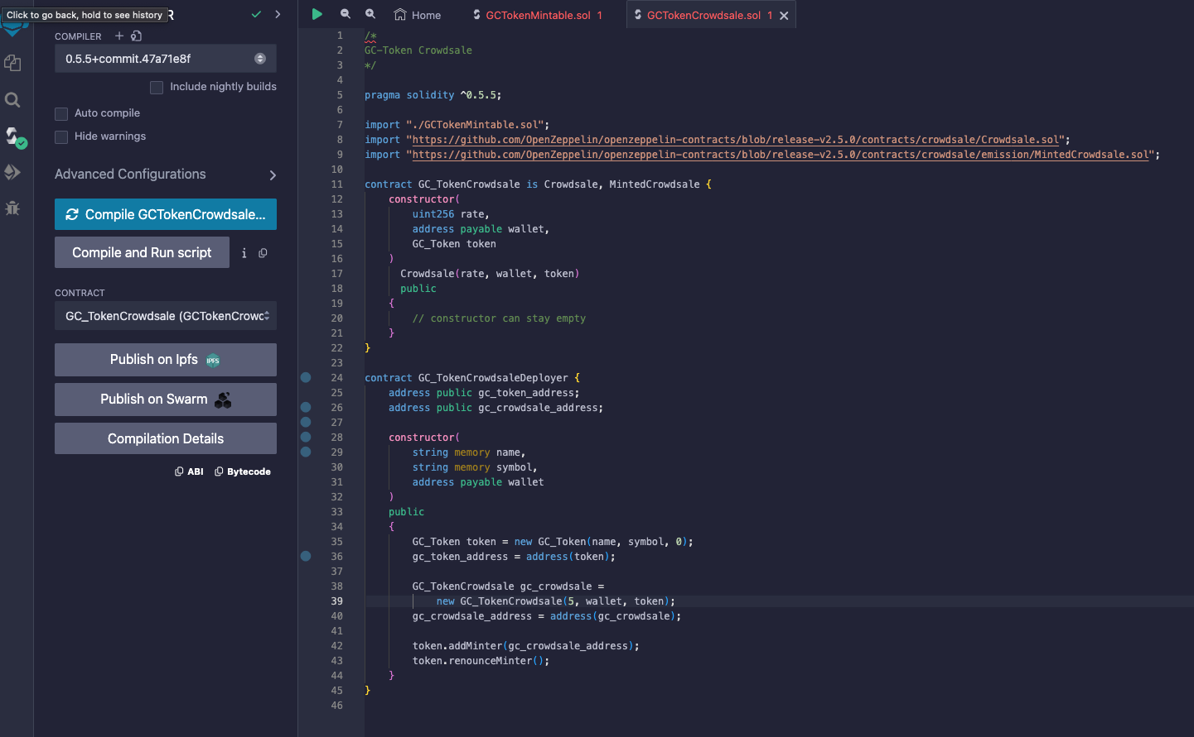
Compile the crowdsale solidity app
Briefer: Sam Muslin

Slide 8
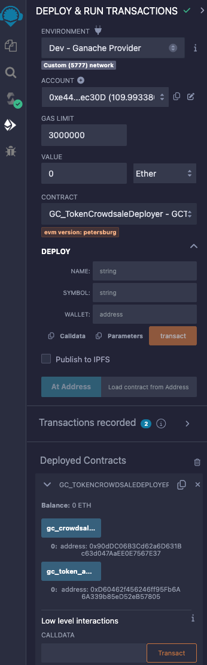

Deployment of crowdsale deployer using token name, symbol, and wallet, resulting in deployed contract
Briefer: Sam Muslin

Slide 9
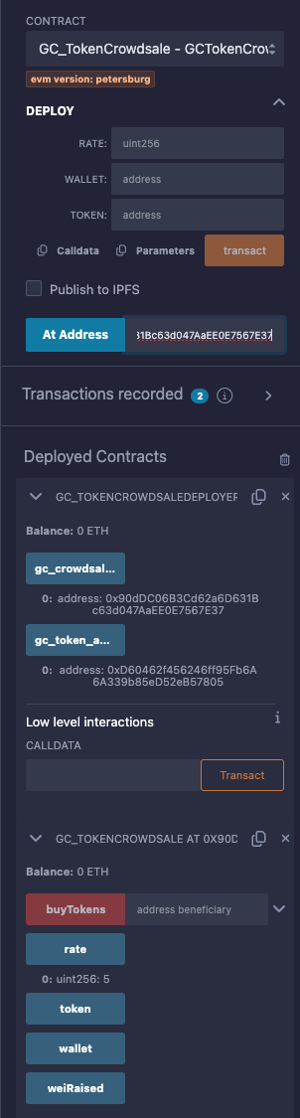
Briefer: Sam Muslin
Deploy Token Crowdsale using at address of crowdsale and resulting deployed crowdsale contract

Slide 10
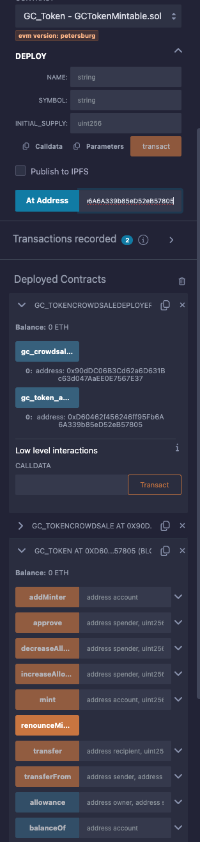
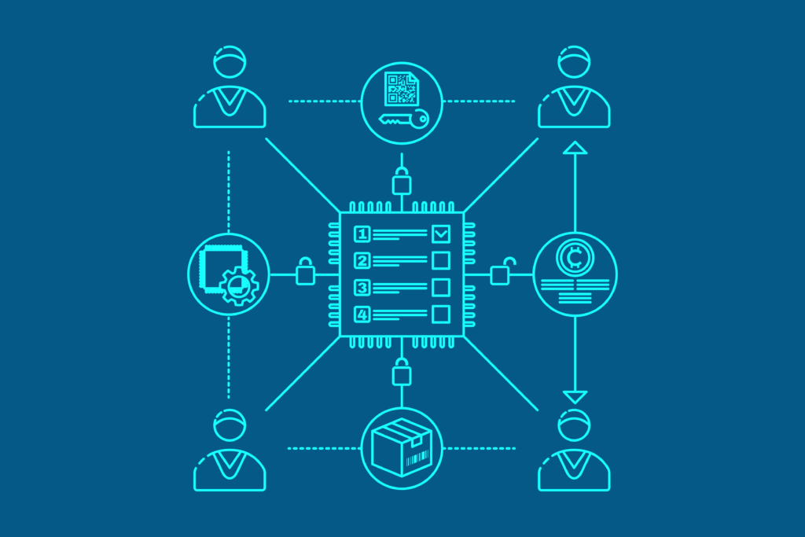
Deploy token using at address of token resulting in deployed token contract
Briefer: Sam Muslin

Slide 11
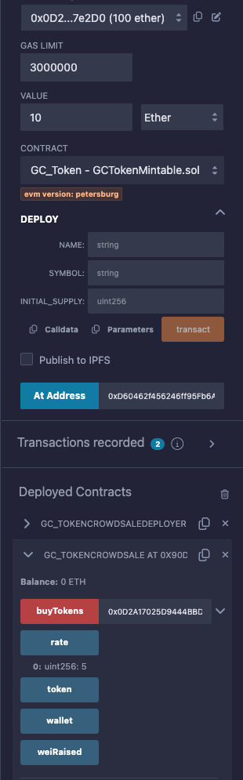
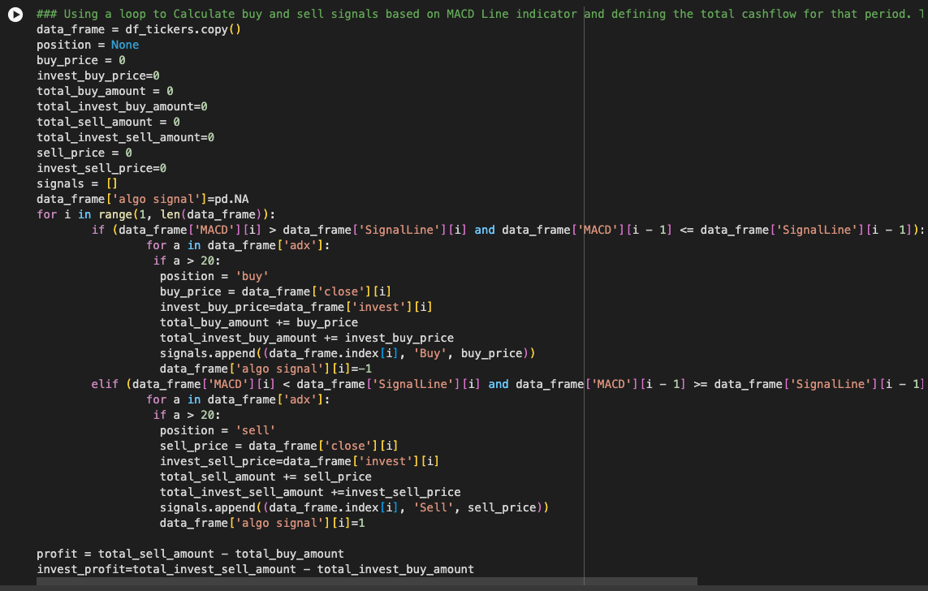
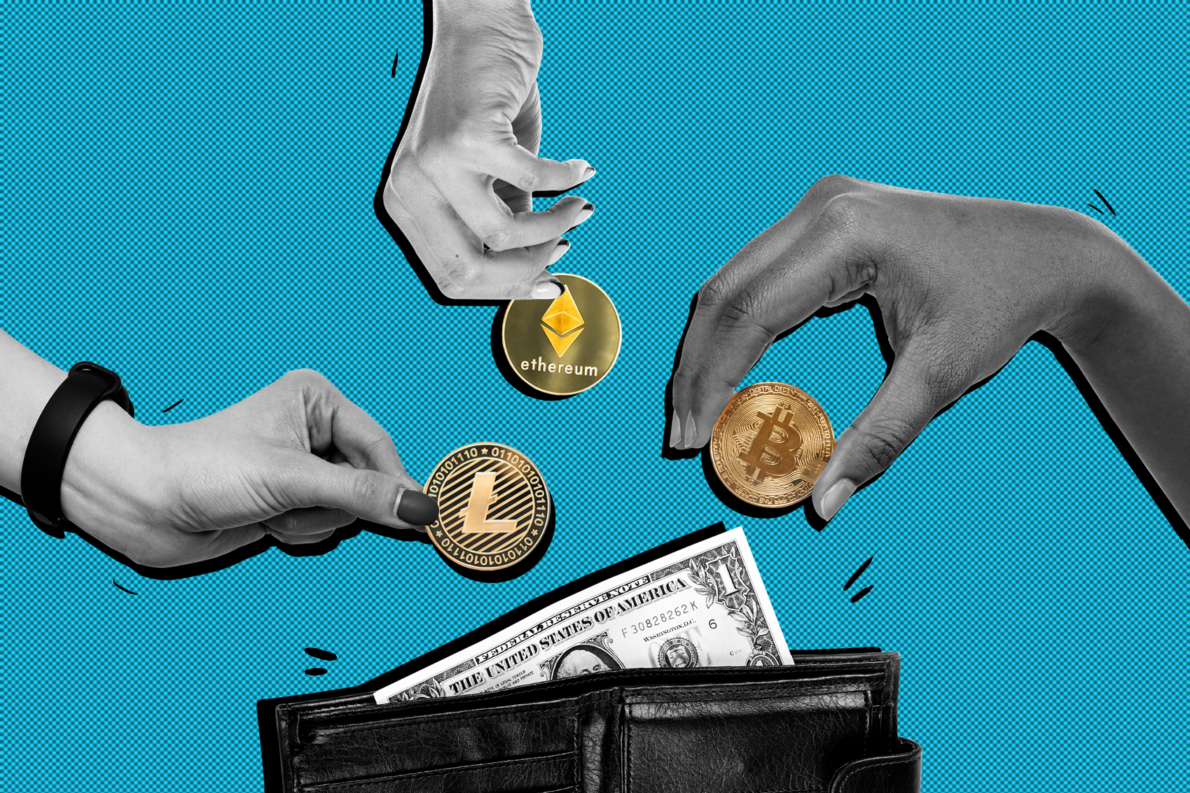
Briefer: Sam
Buy token specifying value and address
Sam[Data format]
What Data did we use and where did we get it from?
How did we access it?

Slide 12
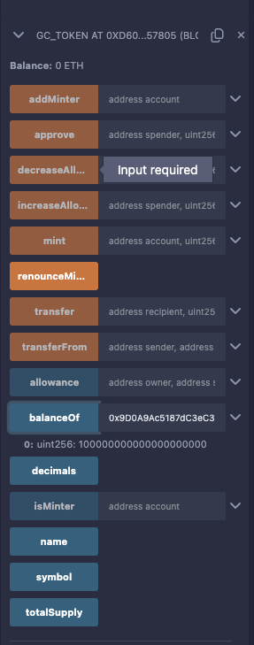
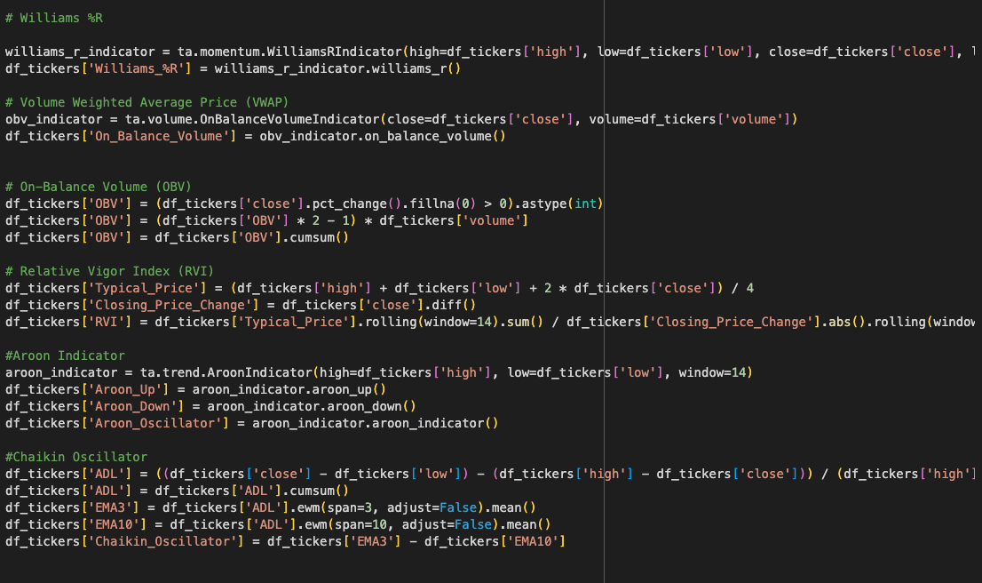
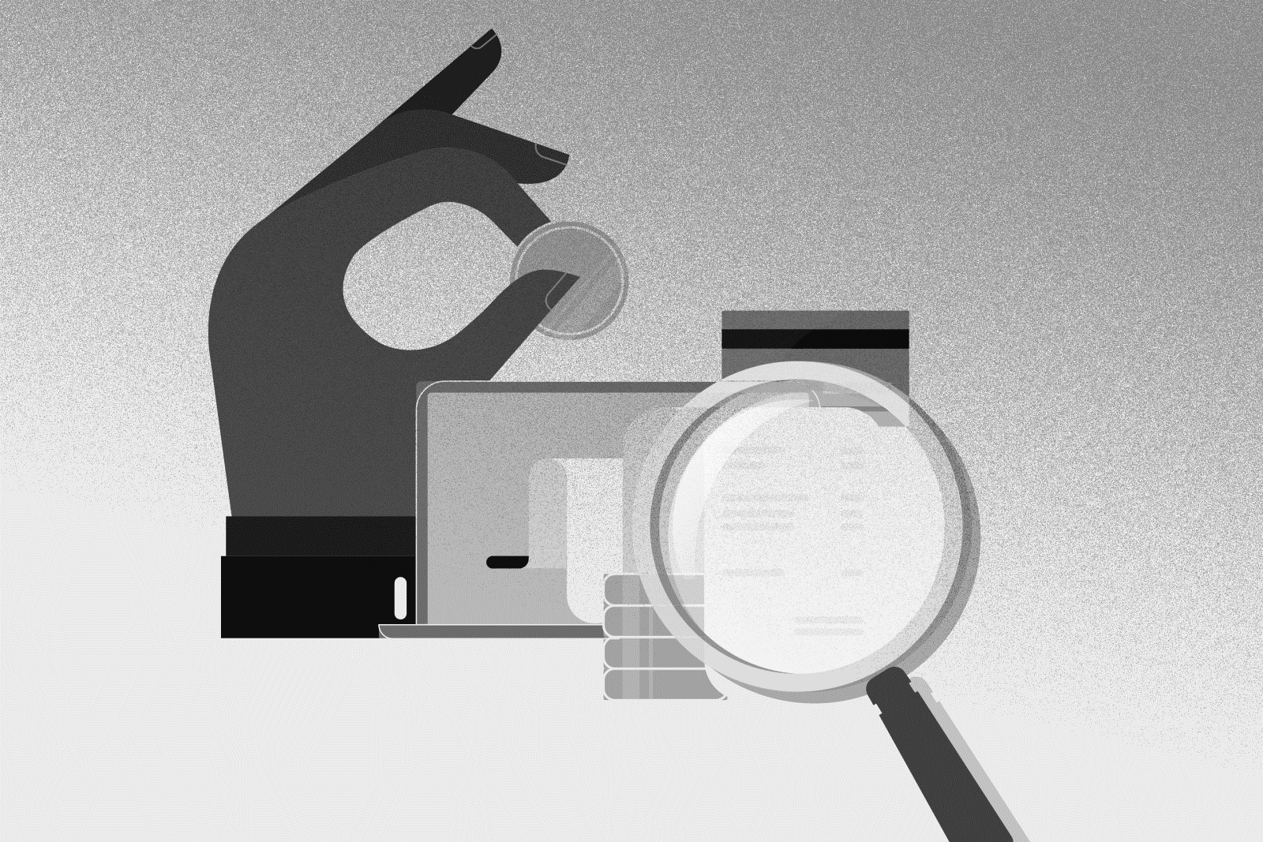
Briefer: Sam Muslin
Check balance of Token
Sam[Data format]
What Data did we use and where did we get it from?
How did we access it?

Slide 13
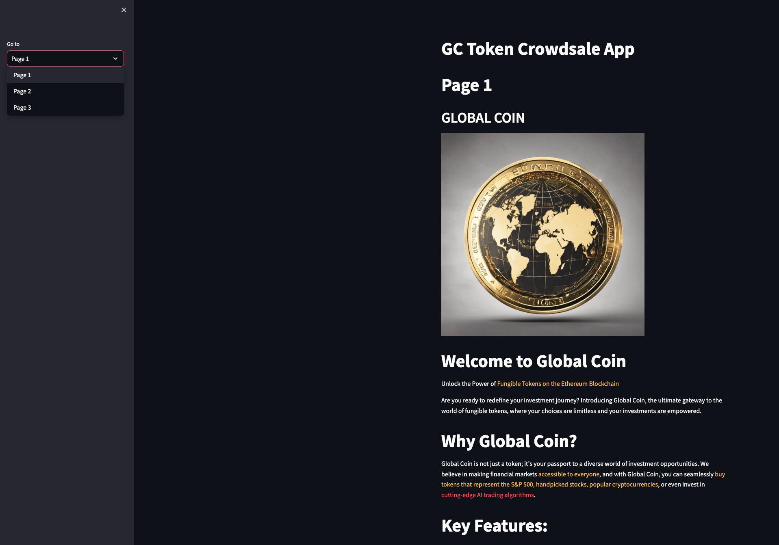
Create an app on Streamlit with 3 pages, where page 1 is the introduction
Briefer: Monty Gash
Sam[Data format]
What Data did we use and where did we get it from?
How did we access it?

Slide 14

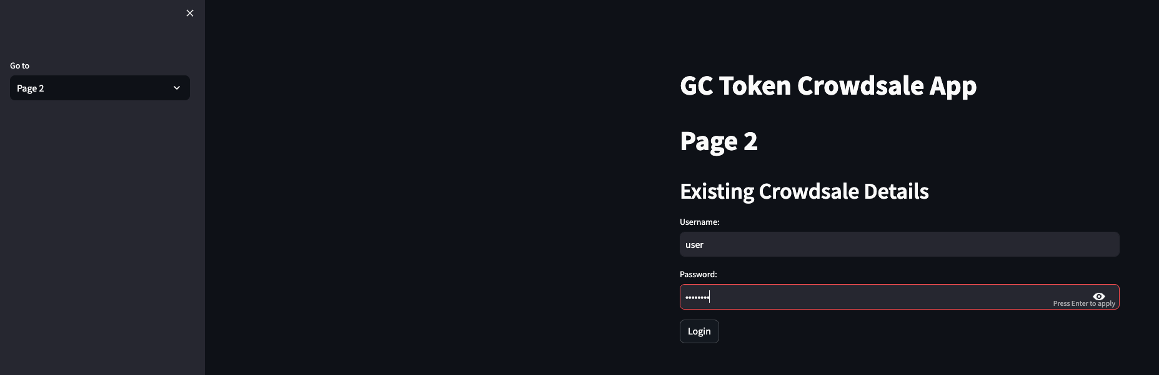
Briefer: Monty Gash
Page 2 & 3 are protected with username and password

Slide 15
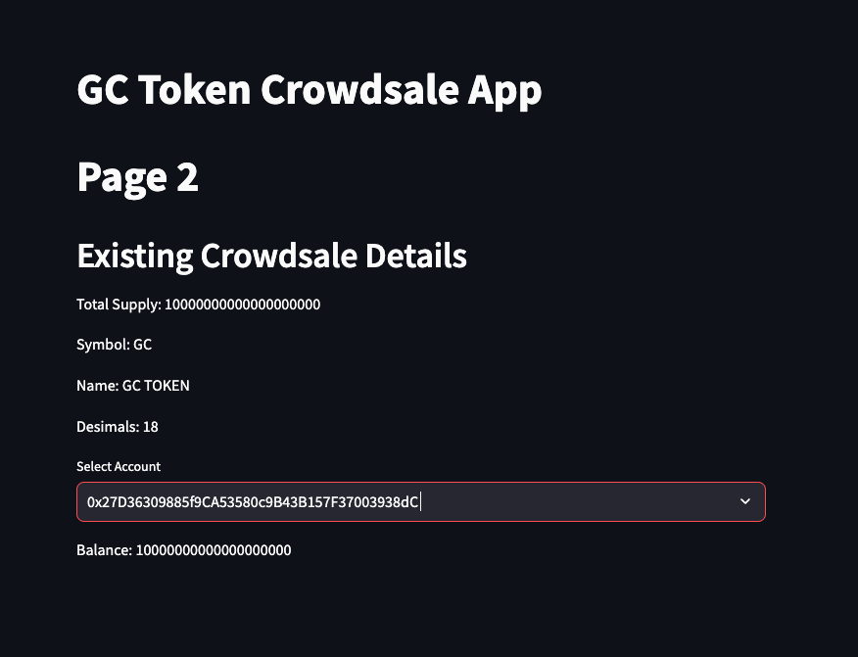
Briefer: Monty Gash
Page 2 is token information with account balance

Slide 16
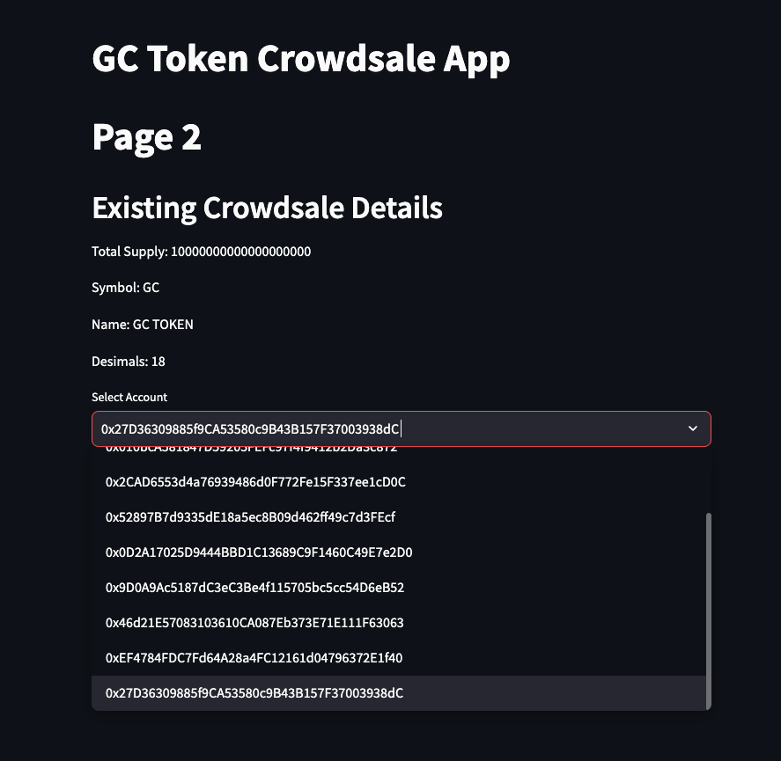
Briefer: Monty Gash
Choosing between different accounts
Sam[Data format]
What Data did we use and where did we get it from?
How did we access it?

Slide 17
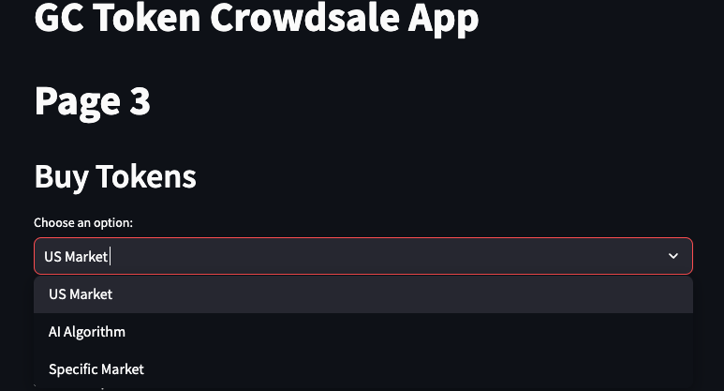
Briefer: Monty Gash
Page 3: Token buying options
Sam[Data format]
What Data did we use and where did we get it from?
How did we access it?

Slide 18
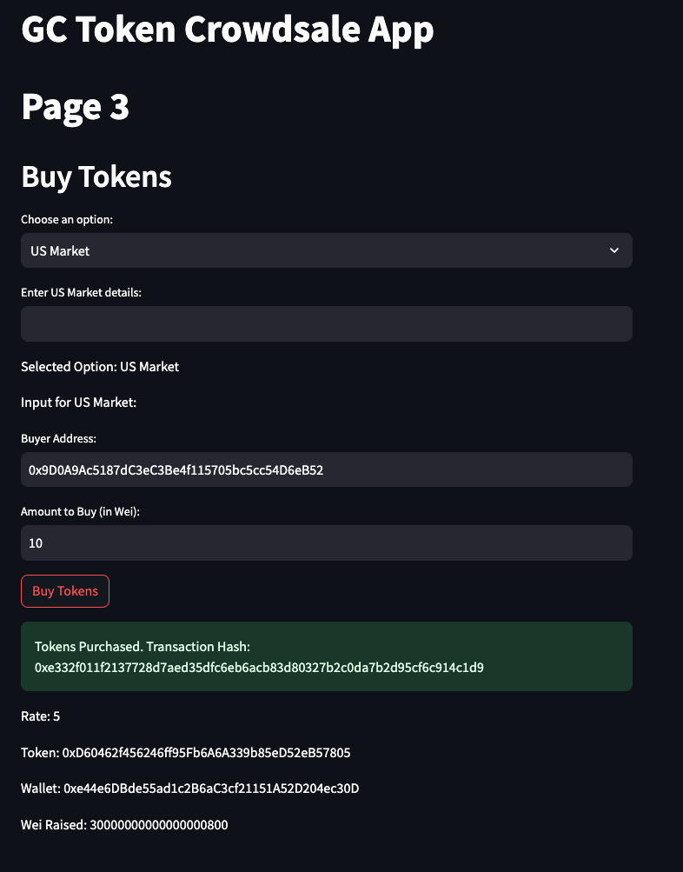
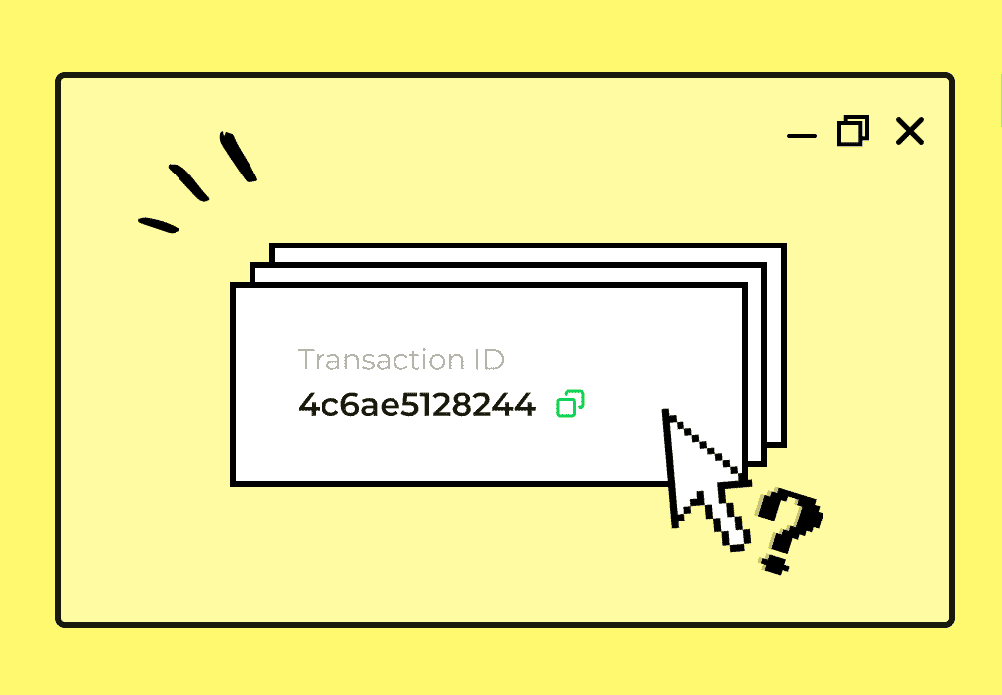
Page 3: Buy token using address and amount, resulting in transaction hash
Briefer: Monty Gash
Sam[Data format]
What Data did we use and where did we get it from?
How did we access it?

Slide 19
Briefer: Harith Alshuwaykh
Flow Chart
Compile solidity apps
Connect Remix to Ganache
Connect Streamlit to Ganache
Deploy Crowdsale deployer
Token Contract
Crowdsale contract
Token information
Buy tokens

Slide 20

Briefer: Harith Alshuwaykh
Future improvements
Sam[Data format]
What Data did we use and where did we get it from?
How did we access it?
Connect ChainLink input to the Streamlit app
Connect trading algorithm to Streamlit app
Show live graphs from the market representing the token’s value; track the accounts as they build value
Add an oracle to connect chainlink for up to the minute pricing
Philanthropy options

Slide 21


